Slide 1

Practical
Machine Learning
With Python

Slide 2

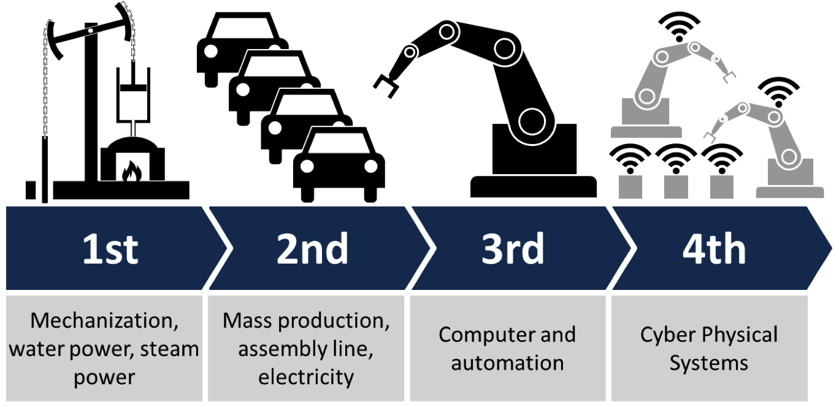
Notes:
1. Our World is changing, one thing that impact our life is artificial intelligence. AI bringing an new industrial revolution, previous industrial revolution expanded human mechanical power (machines, motors etc) now this new machine age expanding human cognitive power, mental power. Nowadays computer not only replacing mechanical labours but also replacing metal labours, i.e., AI giving is computer the ability to think. So where we stand today ?

Slide 3
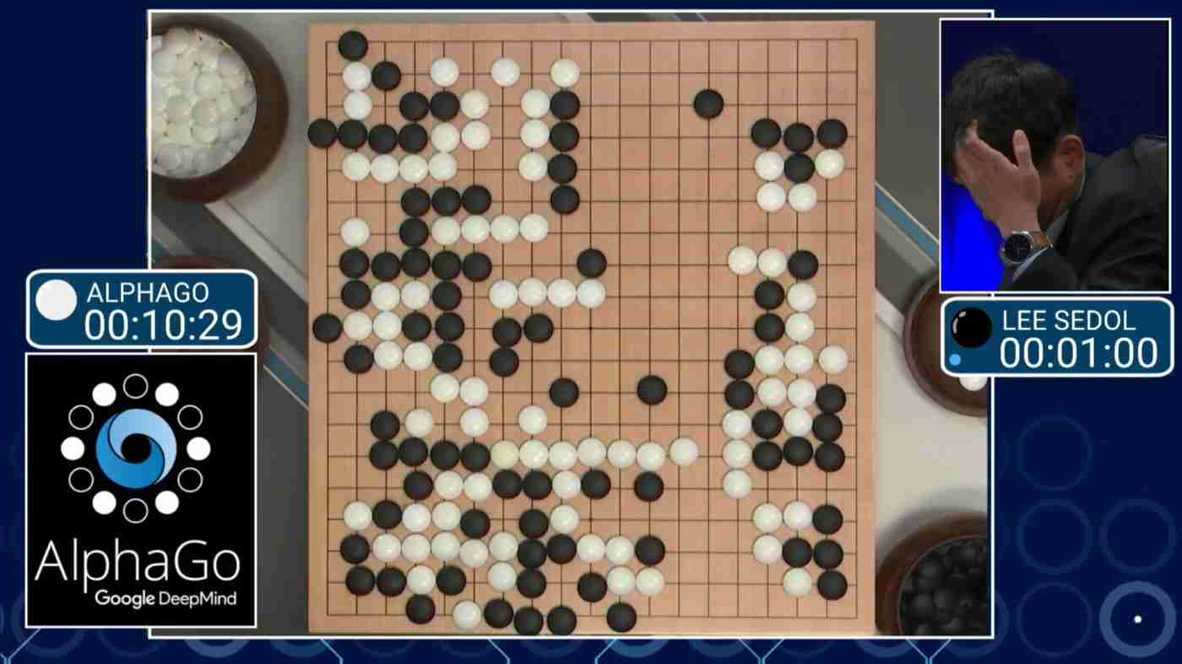
“Deep Learning beats Go world Champion”
Notes:
You may heard in 2016, March an machine learning algorithm name “AlphaGo” beats a world champion in the game called “GO” which is biggest break through in AI history. Go is a ancient Chinese game which has many combination than chess. It is difficult for computers to master that game. How it master that game?....... AlphaGo

Slide 4
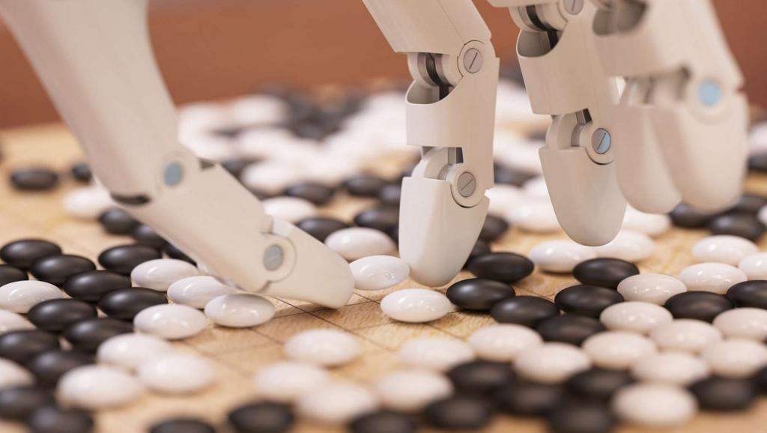
Learning by practicing over and over again
Notes:
AlphaGo put in a environment where group of people (professional) playing a game and make it to observe moves, then allows computers to play itself, million of times.

Slide 5
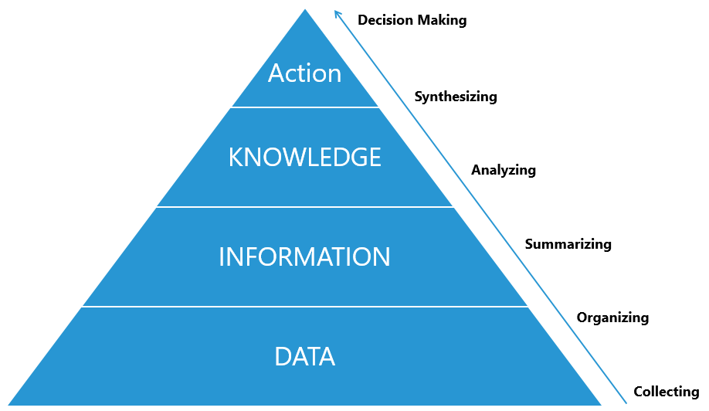
Learning from Data
Notes:
Machine Learning allows to learn from examples. ie., to learn from data contains information. Machine learning is a key to clone knowledge into computer. This is important, because knowledge is what enable intelligence. Putting a knowledge into computer is difficult, from previous approaches, why ?
There are many things which we know intuitively so we cannot communicate them verbally we do not have conscious access to that intuitive knowledge. how can we program computers with that knowledge what's the solution

Slide 6
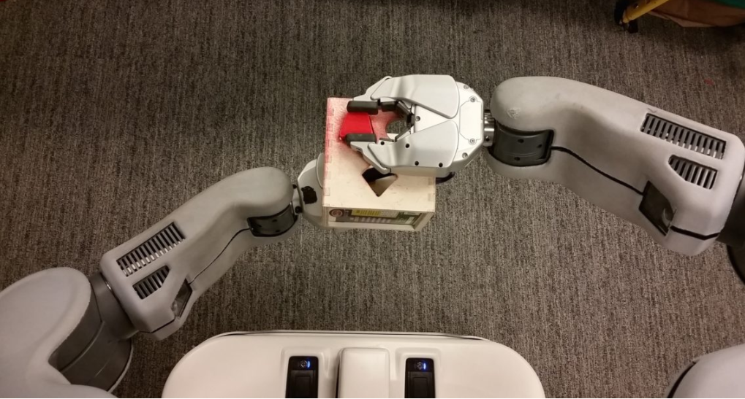
“Machine to learn that knowledge by themselves just as we do”
Notes:
the solution is for machines to learn that knowledge by themselves just as we do. this is important because knowledge is what enables intelligence my mission has been to contribute to discover and understand principles of intelligence through learning whether animal or human or machine learning

Slide 7
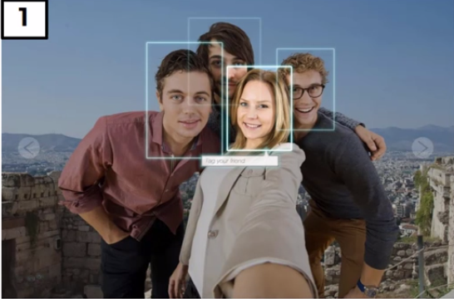
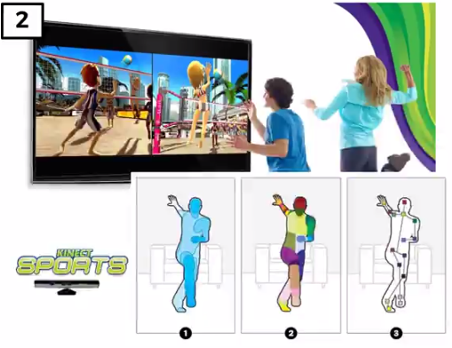
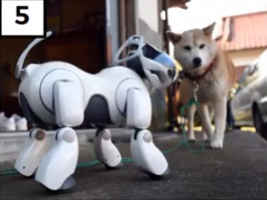
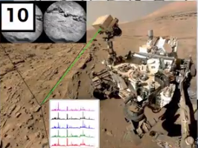

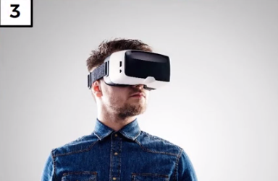
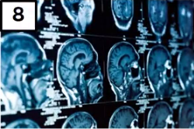
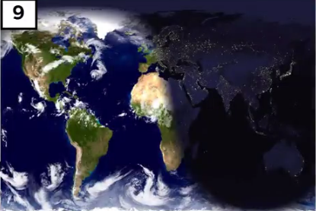
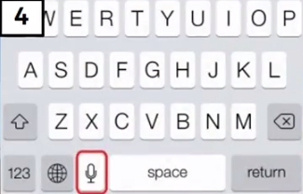

Applications of Machine Learning
Applications of AI

Slide 8
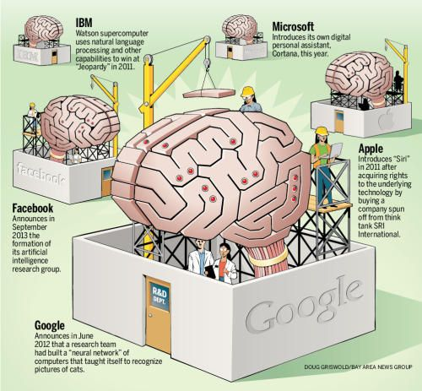
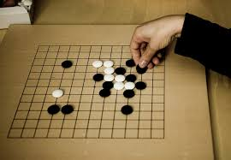
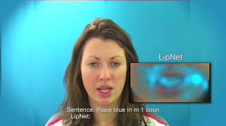

A computer wins at the world's hardest boardgame
Machines and humans pair up to fight fraud online
2016
Natural language processing gives life to a digital personal shopper
Read my lips, LipNet
A machine learns how to stop online trolling

Slide 9
“Don’t be fooled we are still very very far from a machine that would be as able as humans to learn to master many aspects of our world” - Yoshua Bengio

Slide 10

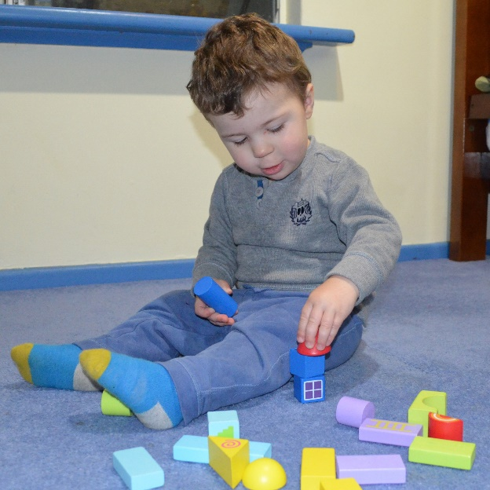
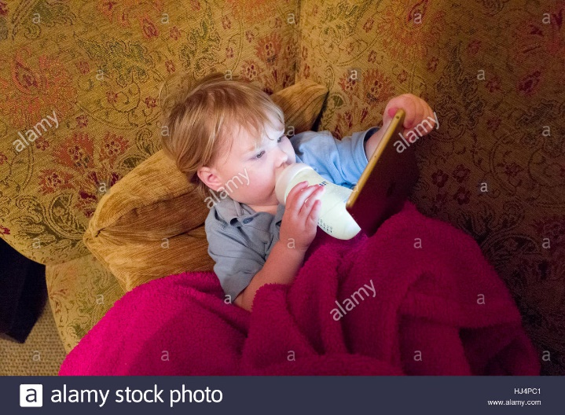
Child learn thing that computer are not able to do right now

Slide 11

Computer Learning
Application of deep learning is what we call supervised learning.
With Supervised learning the computer need to be taken by hand and humans have to tell the computer the answers to many questions

Slide 12
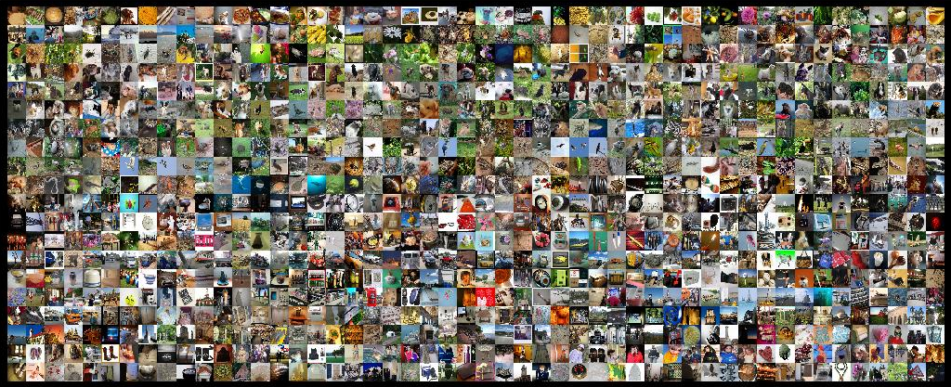
Humans Teaching Computers

Slide 13
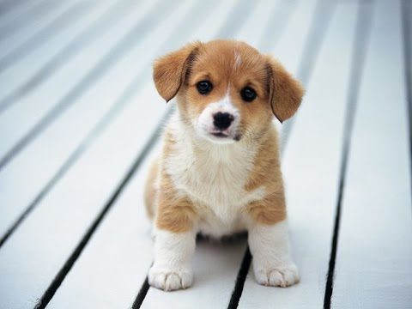
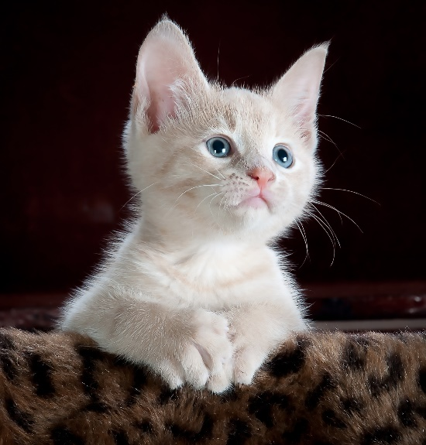

Humans teaching Computers
Although it is painful, it is very powerful which solves many interesting problems.

Slide 14
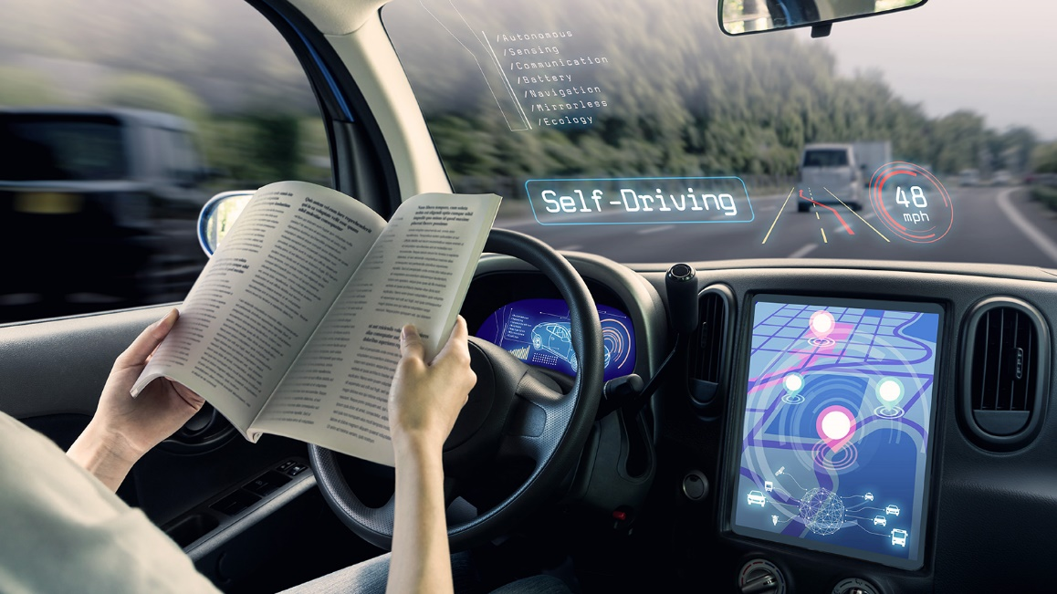
2 year old child is much stronger
2 year old child learning about unsupervised learning helps to deal with “Self-Driving cars”

Slide 15
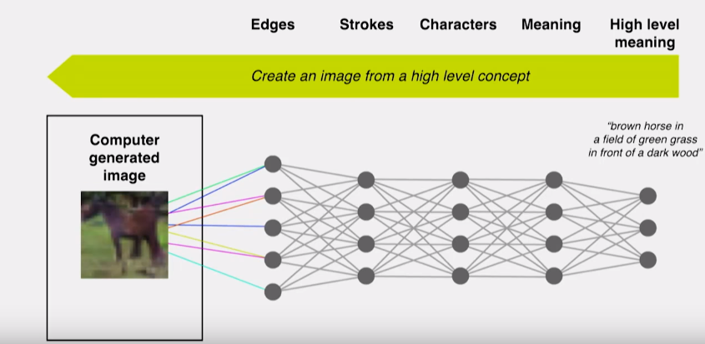
Model to be Creative

Slide 16
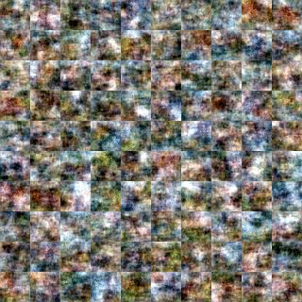
Computer Generate Image
Just like our dreams which is creative and generate new images, new abstracts

Slide 17
What's next in Machine Learning?
It will be part of your life

Slide 18
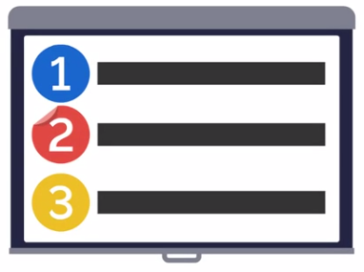
Let’s get give you a quick overview of the course!

Slide 19





Slide 20




We start with a quick crash course in the essential Python data Science libraries!

Slide 21
Ready

Slide 22
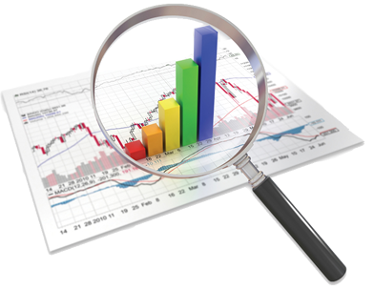
Data

Slide 23
Data and Data Sets
Data are facts and figures collected summarized, analyzed and interpreted.
The data collected in a particular study are referred to as dataset.

Slide 24
Types of Data
Data are classified into two types:
Qualitative data
Quantitative data
Based on Mathematical properties
Nominal
Ordinal
Interval
Ratio
Categorical (Qualitative)
Numerical
(Quantitative)
Ordinal
Interval
Nominal
Ratio

Slide 25
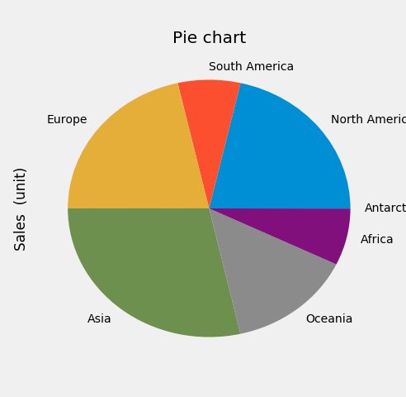
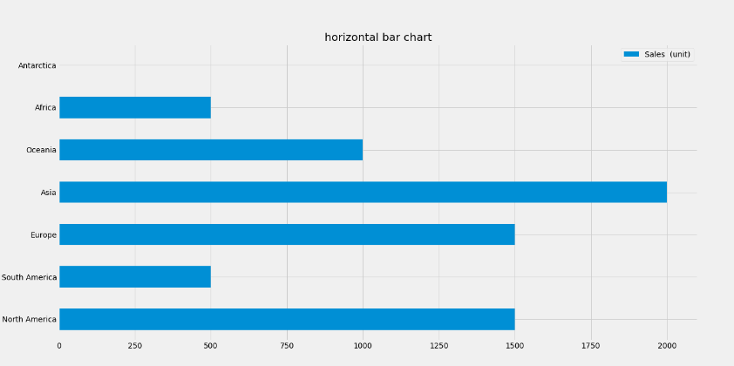
Nominal Data (Qualitative)
Nominal means name and count
Data are alphabetic or numerical in name
They are categories without order or direction
They use to keep track of people, objects and events.
Continent | Sales (unit)
North America | 1,500
South America | 500
Europe | 1,500
Asia | 2,000
Oceania | 1,000
Africa | 500
Antarctica | 1

Slide 26
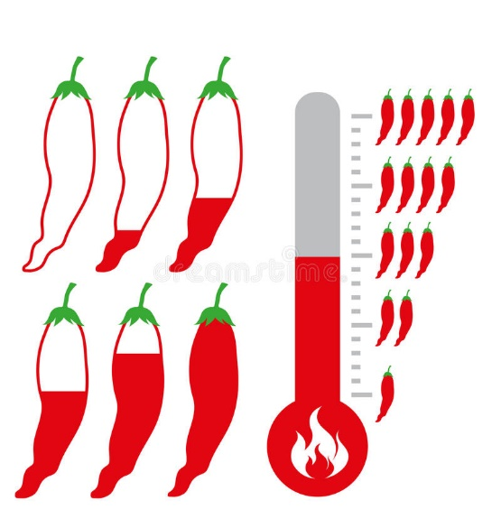
Ordinal Data (Qualitative)
Ordinal means rank or order
Data place in order. They are ordered categories like ranking
or scaling.
Has no absolute value
More precise comparison are not possible

Slide 27
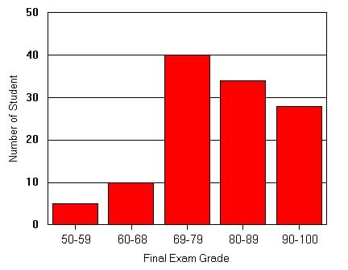
Interval Data (Quantitative)
Interval data in addition to ranking further allow forming difference.
For interval data there is no absolute zero. Unique origin does not exists.
Interval data are more powerful than ordinal scale due to equality of interval.

Slide 28
Ratio Data (Quantitative)
Ratio data allow for forming quotients in addition to setting up inequalities and forming difference.
All mathematical operations are possible on ratio data.
The most precise data and allows for applications of all statistical techniques.
Has absolute zero.

Slide 29
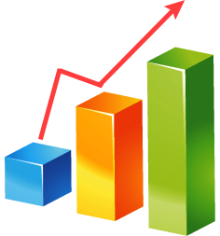
Statistics

Slide 30
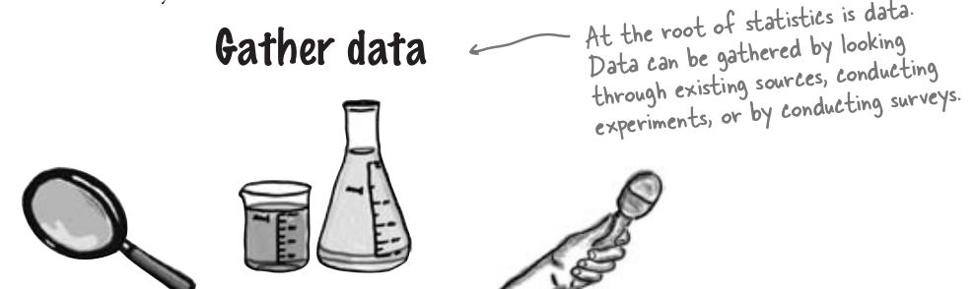
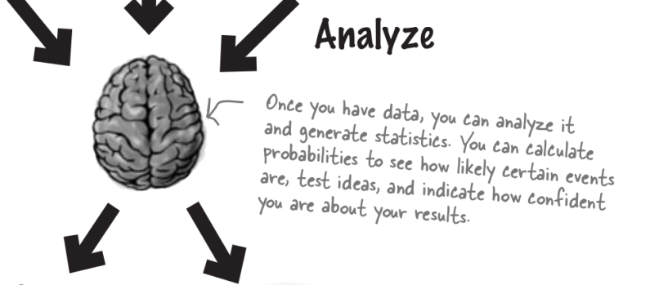
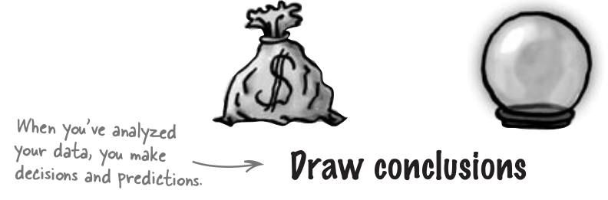
Statistics
“Statistics are numbers that summarize raw facts and figures in some meaningful way”

Slide 31
Statistics
Descriptive Statistics
Inferential Statistics

Slide 32
Descriptive Statistics
Descriptive Statistics are the tabular, graphical, and numerical methods used to summarize data
It is term applied to Meaningful Data Analysis.
Generally involves organizing summarizing large amount of data. So that it is easy to interpret.

Slide 33


Descriptive Statistics
It will describe central tendencies of those scores
Mean
Median
Mode
Variance
Standard Deviation
Math Score in Class

Slide 34

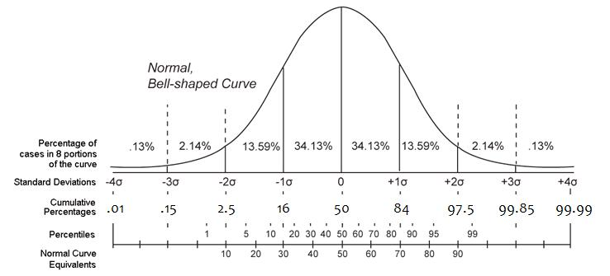
Mean
Math Score in Class

Slide 35

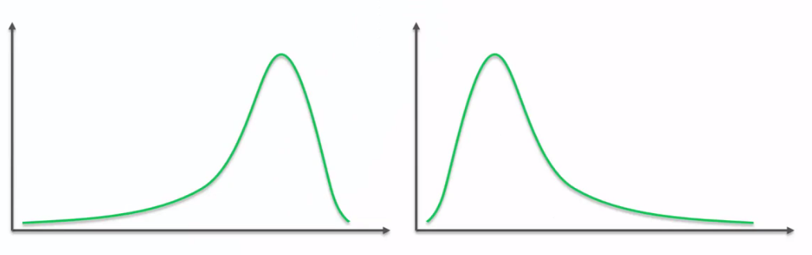
Math Score in Class
Mean
Left (negative) Skew
Right (positive) Skew

Slide 36
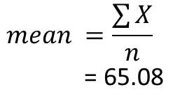
Math Score in Class
Mean
$$mean =\frac{\sum{X}}{n}$$
= 65.08
[58.8, 59.9, 61.2, 61.3, 61.5, 62, 62.5, 62.5, 63, 63, 63.7, 63.9, 64, 64, 65.1 , 65.2, 66.7, 67.8, 68.3, 69.9, 70.7, 71.8, 72.2, 73]

Slide 37
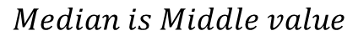
Math Score in Class
Median
$$Median is Middle value$$
[58.8, 59.9, 61.2, 61.3, 61.5, 62, 62.5, 62.5, 63, 63, 63.7, 63.9, 64, 64, 65.1 , 65.2, 66.7, 67.8, 68.3, 69.9, 70.7, 71.8, 72.2, 73]

Slide 38
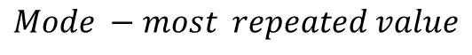
Math Score in Class
Mode
$$Mode −most repeated value$$
[58.8, 59.9, 61.2, 61.3, 61.5, 62, 62.5, 62.5, 63, 63, 63.7, 63.9, 64, 64, 65.1 , 65.2, 66.7, 67.8, 68.3, 69.9, 70.7, 71.8, 72.2, 73]

Slide 39
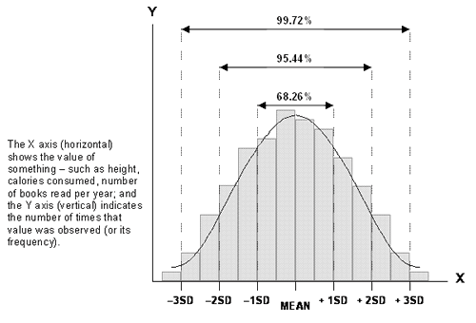
Measuring Variability and spread

Slide 40
Range to differentiate between dataset
It is quite often, the average only gives part of the picture.
Averages give us a way of determining where the center of a set of data is, but they don’t tell us how the data varies.
“The range tells us over how many numbers the data extends, a bit like measuring its width.”

Slide 41
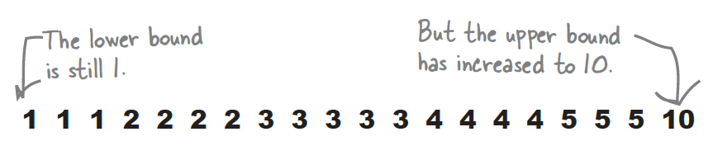
Range
The range is a way of measuring how spread out a set of values are. It’s given by Upper bound - Lower bound where the upper bound is the highest value, and the lower bound the lowest.
Range = upper bound - lower bound
= 10 -1
= 9
so, the range is 9

Slide 42
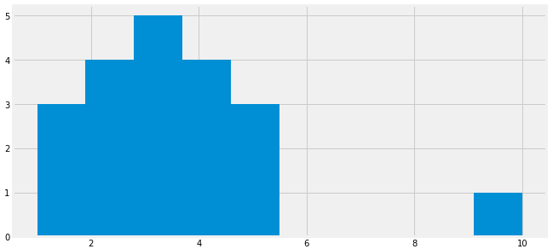
Range Limitation
“If your data has outliers, using the range to describe how your values are dispersed can be very misleading because of its sensitivity to outliers”

Slide 43
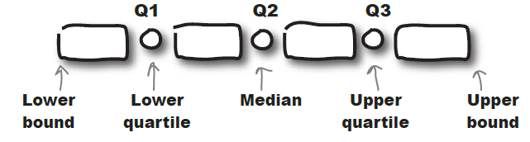
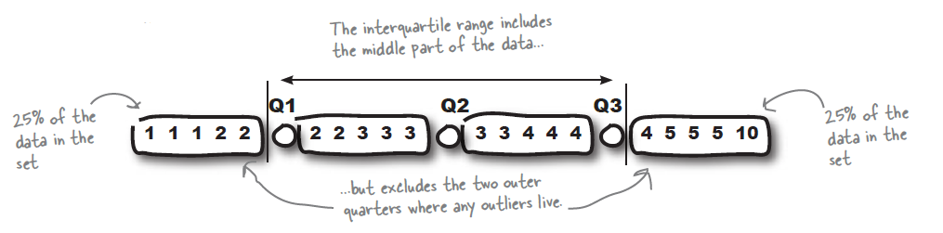
Quartiles will rescue the problem
Quartiles of a set of data is a very similar process to finding the median.

Slide 44
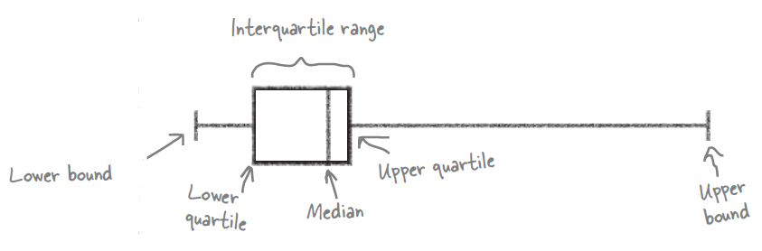
Box plot → Quartiles

Slide 45
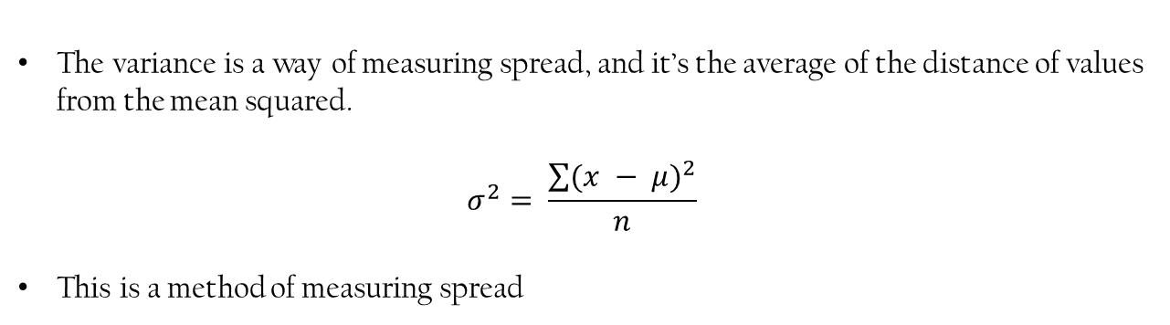
Variance
The variance is a way of measuring spread, and it’s the average of the distance of values from the mean squared.
$$σ^{2}= \frac{\sum{{(x − μ)}^{2}}}{n}$$
This is a method of measuring spread

Slide 46
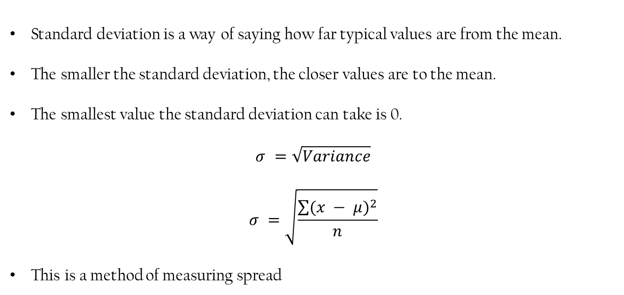
Standard Deviation
Standard deviation is a way of saying how far typical values are from the mean.
The smaller the standard deviation, the closer values are to the mean.
The smallest value the standard deviation can take is 0.
$$σ^{ }=\sqrt{Variance}$$
$$σ^{ }=\sqrt{\frac{\sum{{(x − μ)}^{2}}}{n}}$$
This is a method of measuring spread

Slide 47
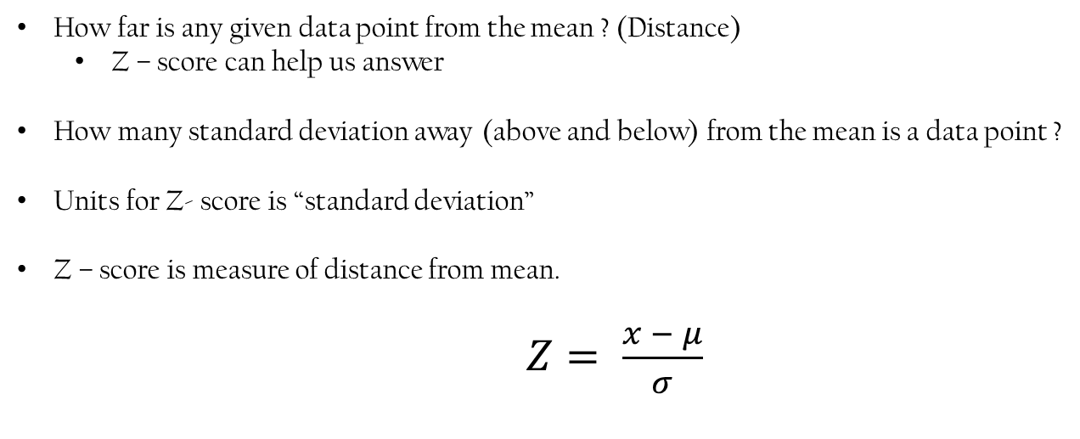
Z - Score
How far is any given data point from the mean ? (Distance)
Z – score can help us answer
How many standard deviation away (above and below) from the mean is a data point ?
Units for Z- score is “standard deviation”
Z – score is measure of distance from mean.
$Z= \frac{x − μ}{σ}$

Slide 48
Z - Score
Value | Mean | value- Mean | Z | Outlier ?
1 | 3.26 | -2.26 | -1.1037 | Not outlier
1 | 3.26 | -2.26 | -1.1037 | Not outlier
1 | 3.26 | -2.26 | -1.1037 | Not outlier
2 | 3.26 | -1.26 | -0.6160 | Not outlier
2 | 3.26 | -1.26 | -0.6160 | Not outlier
2 | 3.26 | -1.26 | -0.6160 | Not outlier
2 | 3.26 | -1.26 | -0.6160 | Not outlier
3 | 3.26 | -0.26 | -0.6160 | Not outlier
3 | 3.26 | -0.26 | -0.1283 | Not outlier
3 | 3.26 | -0.26 | -0.1283 | Not outlier
3 | 3.26 | -0.26 | -0.1283 | Not outlier
3 | 3.26 | -0.26 | -0.1283 | Not outlier
4 | 3.26 | 1.74 | 0.3593 | Not outlier
4 | 3.26 | 1.74 | 0.3593 | Not outlier
4 | 3.26 | 1.74 | 0.3593 | Not outlier
4 | 3.26 | 1.74 | 0.3593 | Not outlier
5 | 3.26 | 2.74 | 0.8470 | Not outlier
5 | 3.26 | 2.74 | 0.8470 | Not outlier
10 | 3.26 | 7.74 | 3.28 | outlier

Slide 49
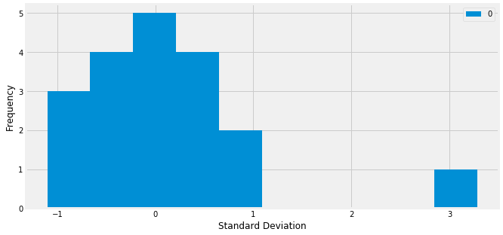
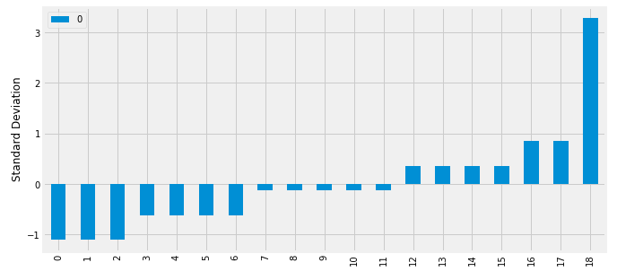
Z - Score

Slide 50
IOTGYAN

